Slide 1

Department of Electrical and Electronics Engineering
BY
S.HARIBALAJI
N.GOKUL
D.GOBINATH
Guide Name: Ms. N.Subhashini, M.E

Slide 2
DUAL AXIS INTENSITY BASED SOLAR TRACKING SYSTEM

Slide 3
Abstract
Our project presents the development of dual-axis solar tracker system based on predictive control algorithms. This prototype of solar tracker was tested and the result has shown the energy output of the solar panel increased by positioning a solar panel directly perpendicular to the sun and gaining the maximum sunlight intensity. The algorithm was programmed using Arduino UNO Controller . The proposed solar time algorithm was used based on the sun’s position and sending the signal to the motor, thus moving the tracker towards the sun automatically. The performance of the system was tested and compared with static solar panel. The results have shown that the solar tracker was increased the percentage harvesting of the PV generation around 21.4%.

Slide 4
Introduction
The problem with the use of solar energy is that is availability varies with the time because of day and night.
Dual axis solar tracker rectifies above problem by having axes of rotation.
Dual axis trackers allow for optimum solar energy levels due to their ability to follow the sun vertically and horizontally.
Here we divide sun position into East , West, North ,South by using the LDR sensor by position having maximum intensity of light.

Slide 5
Essential components
Arduino uno r3
Servo motor sg90 (180 degrees)
Ldr sensor (5mm)
Solar panel (6v)
Resistor (10k)

Slide 6
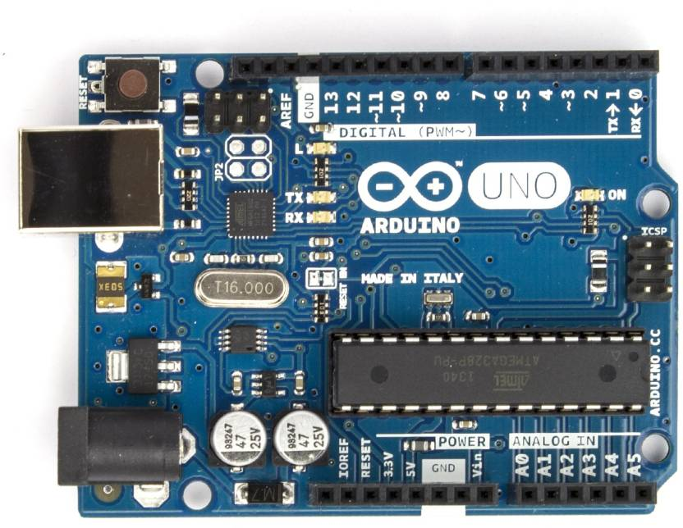
Microcontroller
ARDUINO UNO R3

Slide 7
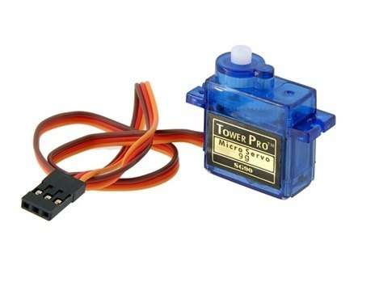
SERVO MOTOR SG90
Servo motor used is sg90 and 180 degree rotation

Slide 8
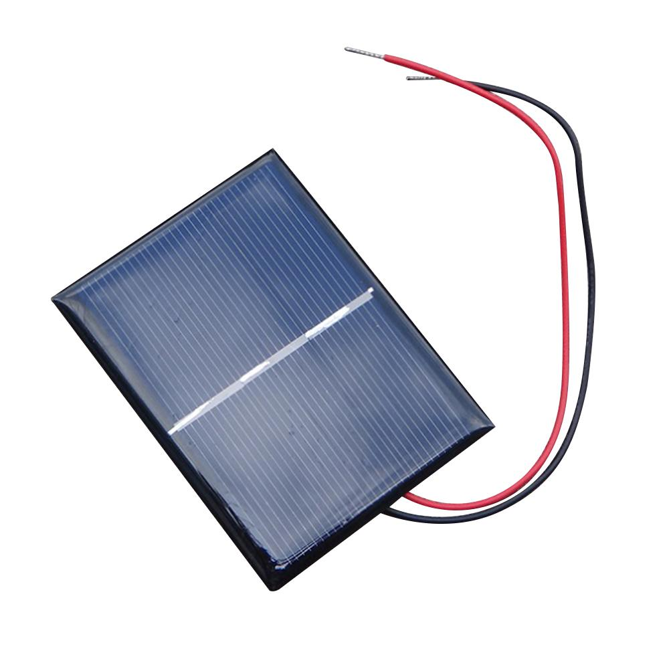
SOLAR PANEL
Solar panel used is 6v and 6w and 100mA

Slide 9
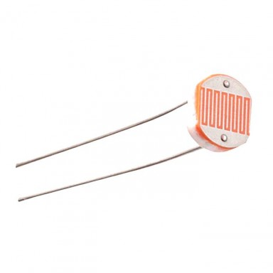
LDR SENSOR
LDR Sensor used is LDR 5mm

Slide 10
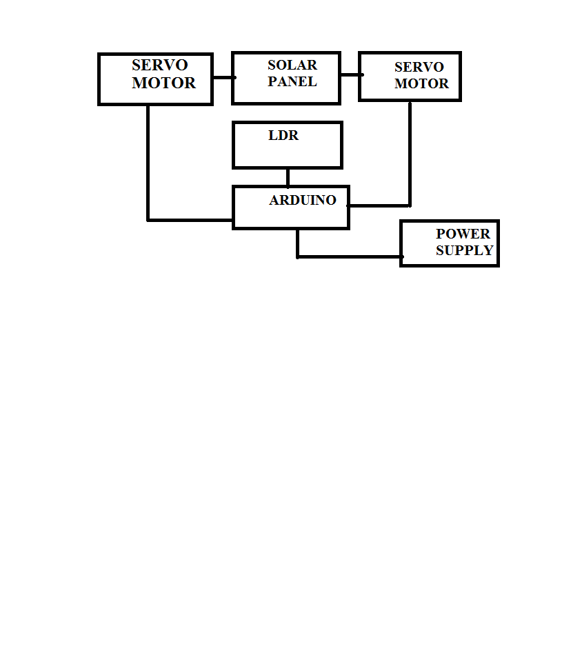
BLOCK DIAGRAM

Slide 11
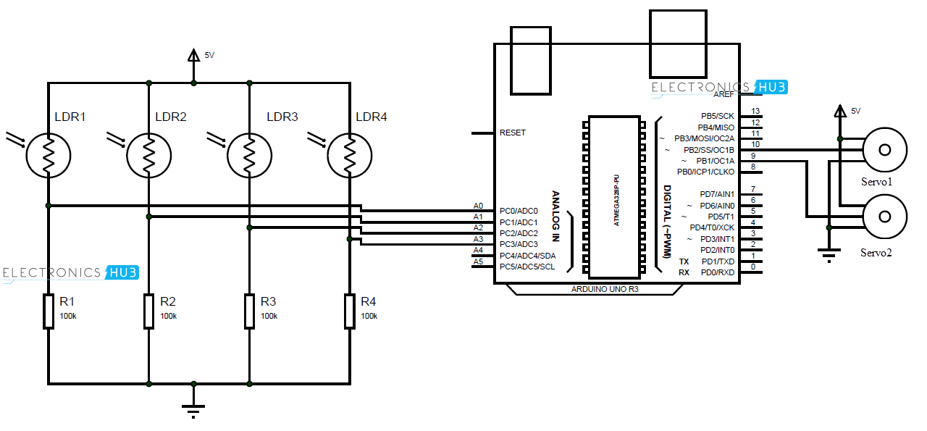
CIRCUIT DIAGRAM

Slide 12
Coding
#include<Servo.h>
int servoh = 180;
int servohLimitHigh = 180;
int servohLimitLow = 65;
int servov = 45;
int servovLimitHigh = 80;
int servovLimitLow = 15;
// LDR pin connections
int ldrlt = 0; //LDR top left - BOTTOM LEFT
int ldrrt = 1; //LDR top right - BOTTOM RIGHT
int ldrld = 2; //LDR down left - TOP LEFT
int ldrrd = 3; //LDR down right - TOP RIGHT

Slide 13
void setup()
{
Serial.begin(9600);
horizontal.attach(9);
vertical.attach(10);
horizontal.write(180);
vertical.write(45);
delay(3000);}
void loop()
{
int lt = analogRead(ldrlt); // top left
int rt = analogRead(ldrrt); // top right
int ld = analogRead(ldrld); // down left
int rd = analogRead(ldrrd); // down right

Slide 14
int avt = (lt + rt) / 2; // average value top
int avd = (ld + rd) / 2; // average value down
int avl = (lt + ld) / 2; // average value left
int avr = (rt + rd) / 2; // average value right
if (avt > avd)
servov = ++servov;
if (servov > servovLimitHigh)
{
servov = servovLimitHigh;
}
else if (avt < avd)
{
servov= --servov;

Slide 15
if (servov < servovLimitLow)
{
servov = servovLimitLow;
}
vertical.write(servov);
}
if (avl > avr)
{
servoh = --servoh;
if (servoh < servohLimitLow)
{
servoh = servohLimitLow;
}

Slide 16
else if (avl < avr)
{
servoh = ++servoh;
if (servoh > servohLimitHigh)
{
servoh = servohLimitHigh;
}
}
else if (avl = avr)
{
// nothing
}
horizontal.write(servoh);
}

Slide 17
WORKING
LDRs are used as the main light sensors. Two servo motors are fixed to the structure that holds the solar panel. The program for Arduino is uploaded to the microcontroller. The working of the project is as follows.
LDRs sense the amount of sunlight falling on them. Four LDRs are divided into top, bottom, left and right.
For east – west tracking, the analog values from two top LDRs and two bottom LDRs are compared and if the top set of LDRs receive more light, the vertical servo will move in that direction.

Slide 18
CONT..
If the bottom LDRs receive more light, the servo moves in that direction.
For angular deflection of the solar panel, the analog values from two left LDRs and two right LDRs are compared. If the left set of LDRs receive more light than the right set, the horizontal servo will move in that direction.
If the right set of LDRs receive more light, the servo moves in that direction.

Slide 19
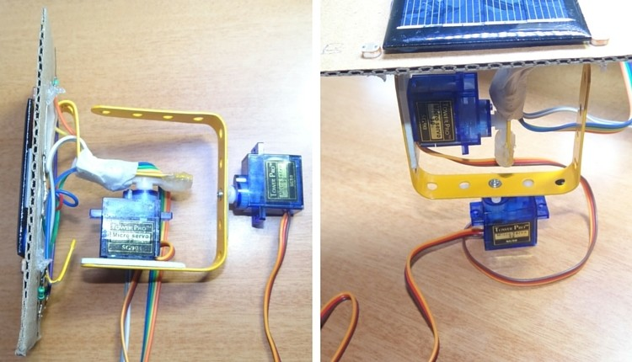

Slide 20
CONCLUSION
This paper has presented a mean of controlling a sun tracking
panel with an embedded microprocessor system. Specifically, it
demonstrates working solution for maximizing solar cell output
by positioning a solar panel at the point of maximum light
intensity. The proposed solution for a solar tracking system
offers several advantages concerning the dual axis movement of
the solar panel: the high system stability; the control algorithm
used has no searching phase; it calculates the position of the sun
and moves the motors towards that sun immediately.

Slide 21
Reference
A. K. Suria; R. Mohamad Idris Dual-axis solar tracker based on predictive control algorithms 2015 IEEE Conference on Energy Conversion (CENCON) Year: 2015
Falah I. Mustafa; A. Salam Al-Ammri; Farouk F. Ahmad Direct and indirect sensing two-axis solar tracking system 2017 8th International Renewable Energy Congress (IREC) Year: 2017
Hassan Fathabadi Novel Online Sensorless Dual-Axis Sun Tracker IEEE/ASME Transactions on Mechatronics Year: 2017
https://www.electronicshub.org/arduino-solar-tracker

Slide 22
THANK YOU

